Slide 1
on LLVM
Roman Stoffel 2011

Slide 2
Overview
Motivation
Scala on LLVM
Challenges
Interesting Subsets

Slide 3
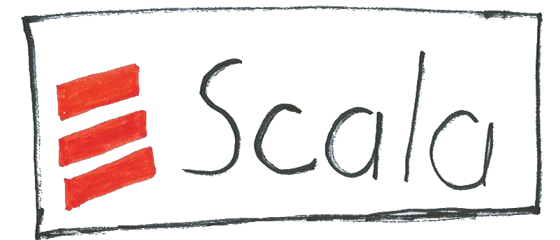
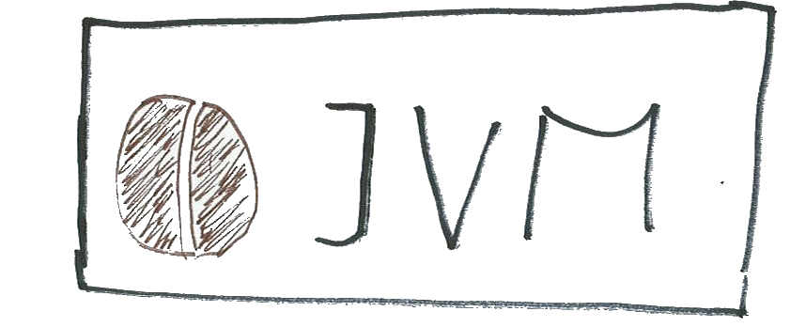
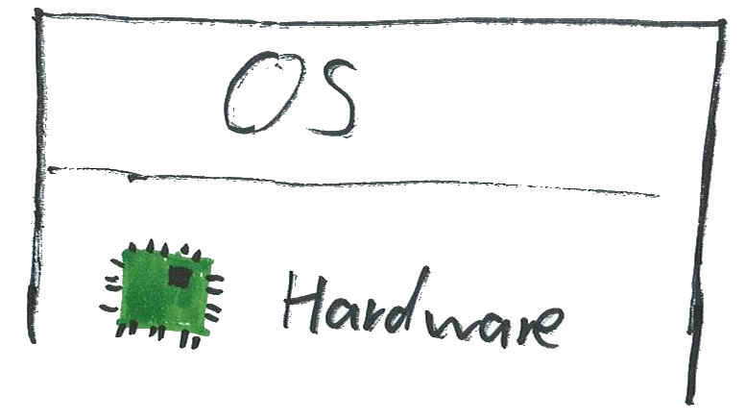
Motivation

Slide 4
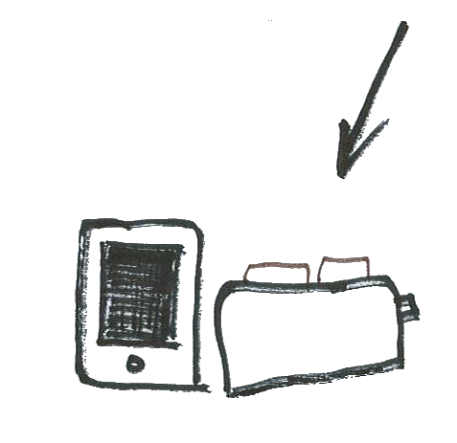
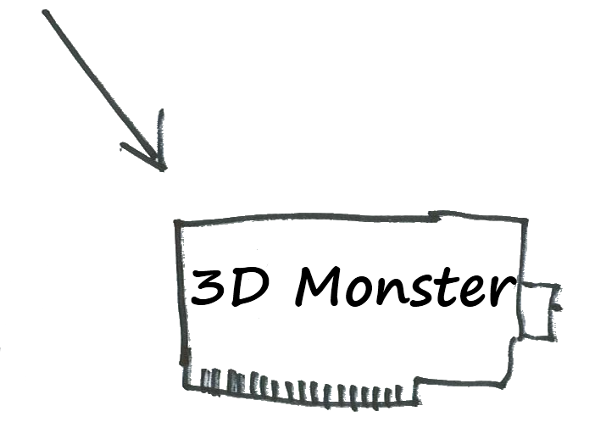
Motivation

Slide 5
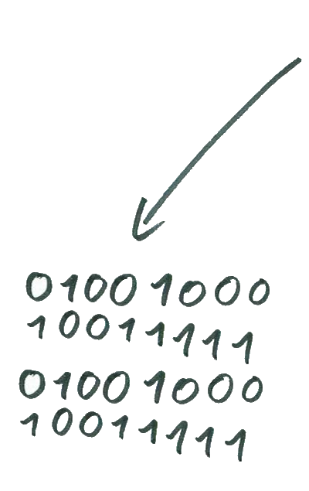
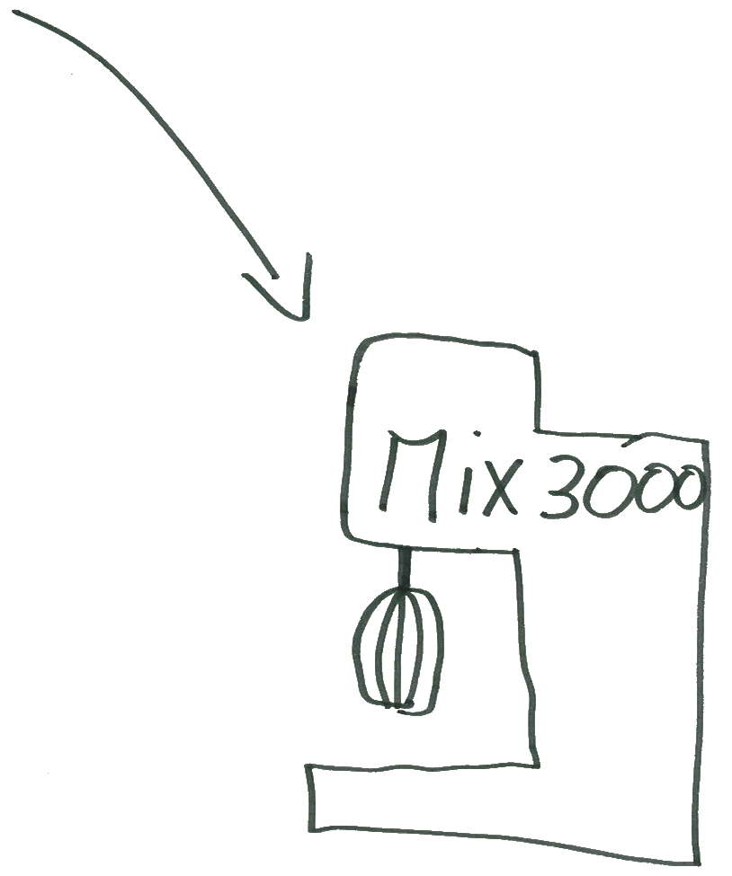
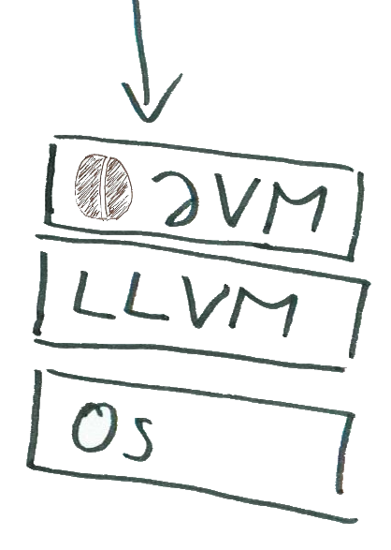
Scala on LLVM

Slide 6
Challenges: Must-Have
Garbage Collector

Slide 7
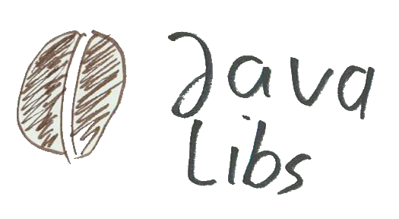
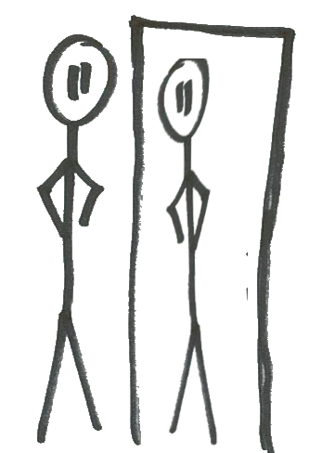
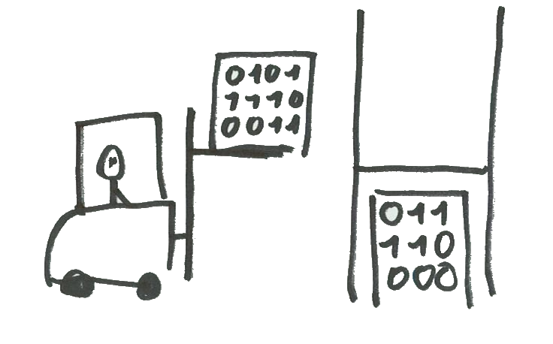
Challenges: Optional
Threading
Reflection
Debugging
Code Loading

Slide 8
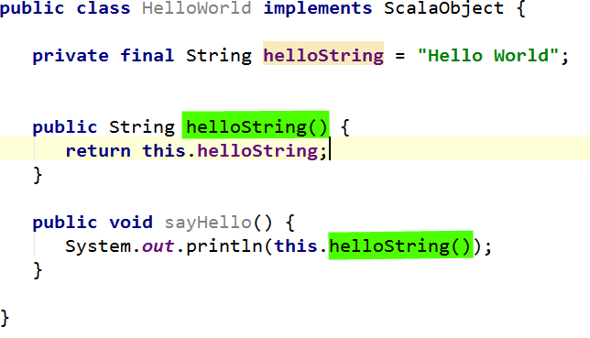
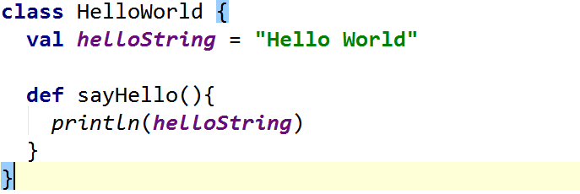
Challenges: Code Loading

Slide 9
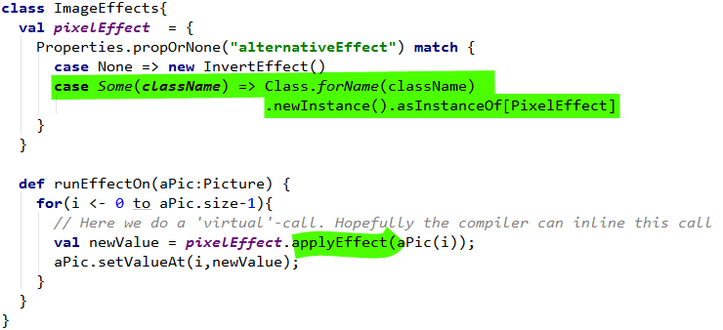
Challenges: Code Loading

Slide 10
Scala Specific Optimisations
Improving Function Handling
Get Rid of Object Overhead
Inlining

Slide 11
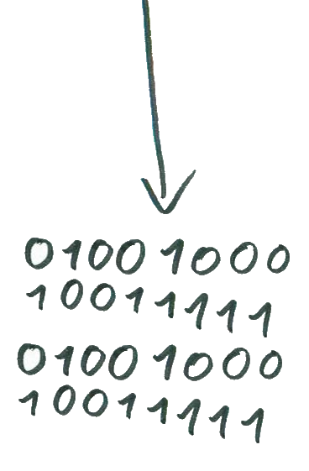
Interesting Subsets
Tiny Scala
On
Small Systems
Compiled Scala
Scala In Flavors

Slide 12
Scala in Flavors

Slide 13
Scala in Flavors
Run the ‘regular’ Code on CPU
Run data parallel on GPU or other dedicated hardware
Issues
Interchanging Data
Vectorisation
Memory-Management

Slide 14
on LLVM
The End

